Slide 1







Concert Coordinator
"Remembering your concert date, so you don't have to"
Hailey Beckworth

Slide 2




SCARED OF OVERBOOKING YOURSELF? NOT AN AGENDA PERSON EITHER?
Concert Coordinator has you enter your data for your upcoming concert, clarifying the dates so you will never overbook yourself again!

Slide 3





Inspired by:
CONDITIONAL TUTORIALS (JUPYTER)
GITHUB CODES
There were not many repositories relating to this project. I used existing repositories to help understand what a proper roadmap should look like as well as the readme file
Using the Jupyter Notebook app, I referenced the absolute beginner module.
This tutorial helped me with elif, if, and inputs

Slide 4



Project Development
My idea maintained the same but changed in some ways
At first, my idea was going to also include how much ticket prices were
To make it less confusing for both the coding development and users, it was more productive to stick to data involving the artist being seen in concert and the date is will occur
Although I did not stick to my original plan, I am proud of the end result of my code

Slide 5

Scope Changes
I was surprised each variable for each conditional did not need specific variables
underestimated the power of if, elif, and else
My change in objectives went from an influx of information to the key components of needing to actually coordinate a live music event

Slide 6
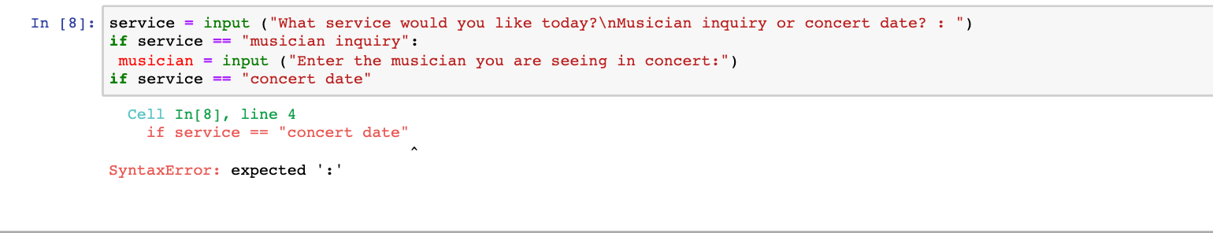


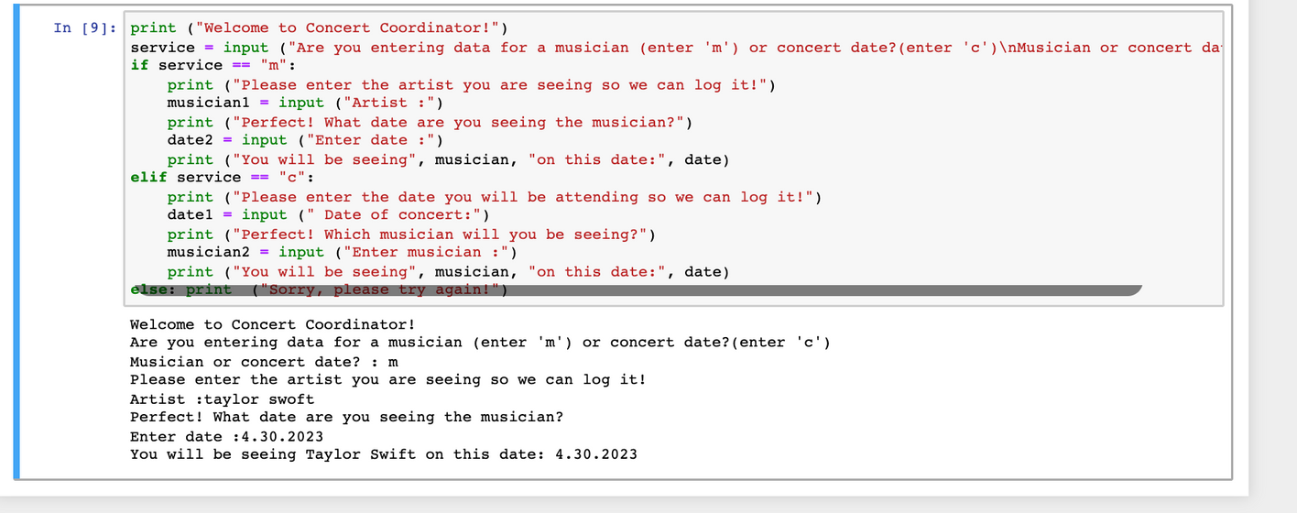
RUNNING THE CODE ERRORS ON MY SIDE
Careless errors
Unneeded variables

Slide 7
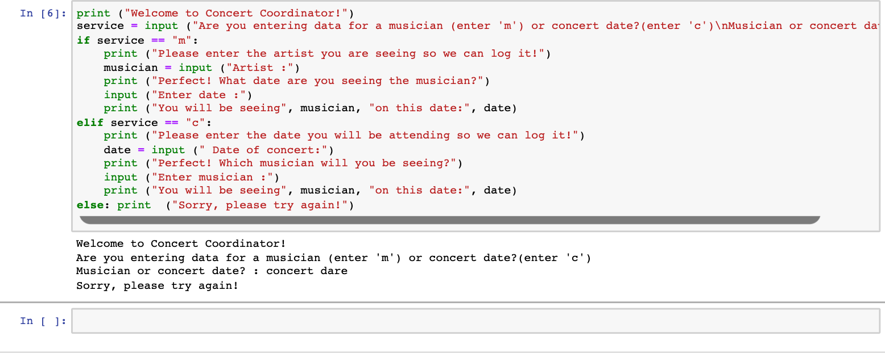
RUNNING THE CODE ERRORS ON USER SIDE
Invalid statements
Prompts user to try again

Slide 8
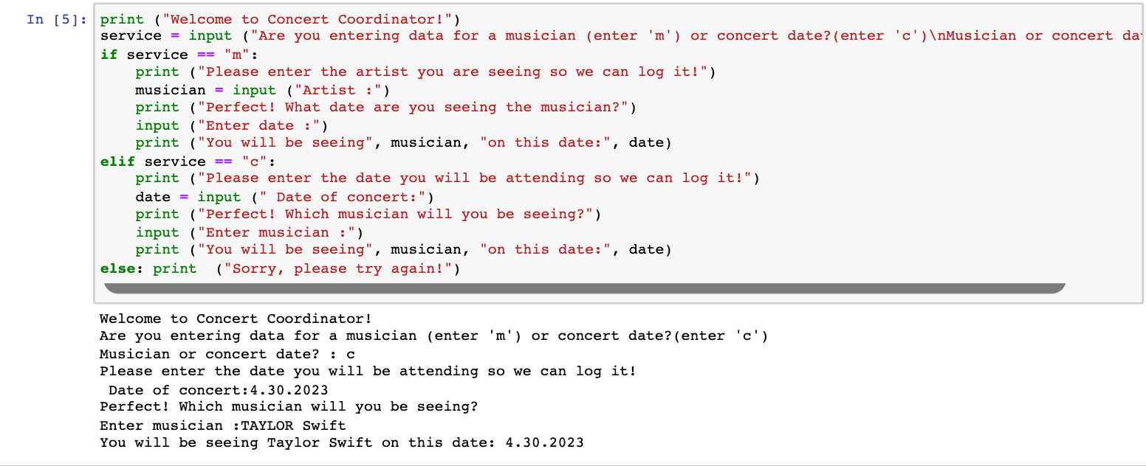


FINAL CODE

Slide 9
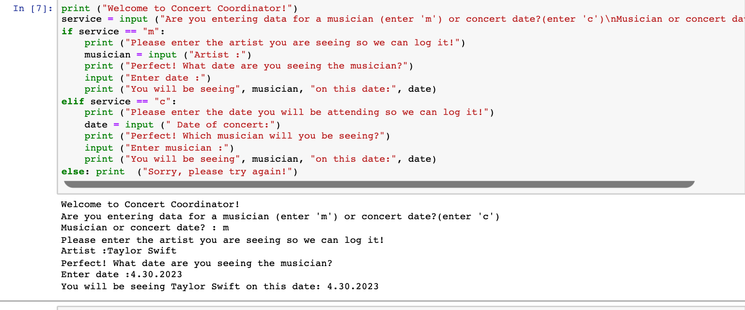


FINAL CODE

